Slide 1

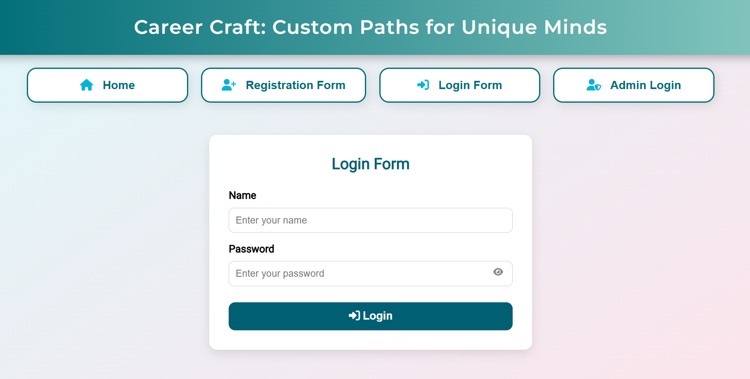
KAKATIYA INSTITUTE OF TECHNOLOGY AND SCIENCE FOR WOMEN

Slide 2

CAREER CRAFTS

Slide 3


Presented By
Our dedicated team has poured their efforts into crafting this solution, under the expert guidance of B. Soundarya Ma'am. This collaborative effort ensures a robust and insightful approach to career guidance.
Shazia Haqqani
Saba Saniya
Syeda Saniya Nimrah
Tasmiya Maheen
(226B1A05A4)
(226B1A05A1)
(226B1A05B1)
(226B1A05B4)
Team Leader
Team Member
Team Member
Team Member
under the guidance of B.Soundarya ma'am

Slide 4
CONTENTS
Abstract
Introduction
Existing System
Proposed System
Modules
System Requirements
Hardware Requirments
Quiz and its stages
Database design
Applications
Conclusion

Slide 5

ABSTRACT
Career Craft is a smart and interactive platform designed to help students choose the right career path based on their interests, skills, and subject strengths. In today's rapidly evolving world, students often face confusion and peer pressure in selecting the right career after their 10th or 12th or further grade. Traditional counseling methods fail to address individual passion and preferences effectively. This project aims to bridge the gap
by introducing a technology-driven solution
that maps a student's interests with suitable
career opportunities.

Slide 6
INTRODUCTION
The Problem
Many students face significant challenges in choosing their career paths. There's a notable lack of awareness about diverse options beyond traditional fields. This leads to immense pressure and an absence of personalized guidance, especially after key academic milestones.
Lack of awareness about diverse career paths
1
Pressure to follow traditional fields (e.g., engineering, medicine)
2
Absence of personalized guidance post 10th, Intermediate, and UG
3

Slide 7



Our Solution
Our solution addresses these challenges by offering a personalized quiz that matches interests with suitable careers. The user-friendly interface provides instant, tailored results, empowering students to explore diverse options confidently.
Personalized Quiz
Aligns interests with suitable career paths.
User-Friendly Interface
Ensures a smooth and intuitive experience for all users.
Instant Results
Provides immediate, tailored career suggestions.

Slide 8
Existing System Limitations
In the existing system, students often rely on manual guidance or random internet searches for career choices. Most tools are generic, paid, or lack proper result analysis and personalization. There's no centralized platform to provide accurate career suggestions based on interests and education level.
1
Shiksha.com
2
Careerguide
3
Edumilestones
College info, career options, entrance exams guidance
Psychometric tests, live counseling
AI career assessment, expert counseling
limitations
limitations
limitations
Focused more on admissions, not career personality fit
Most features paid, test quality varies
Expensive packages, dependent on external counselors

Slide 9
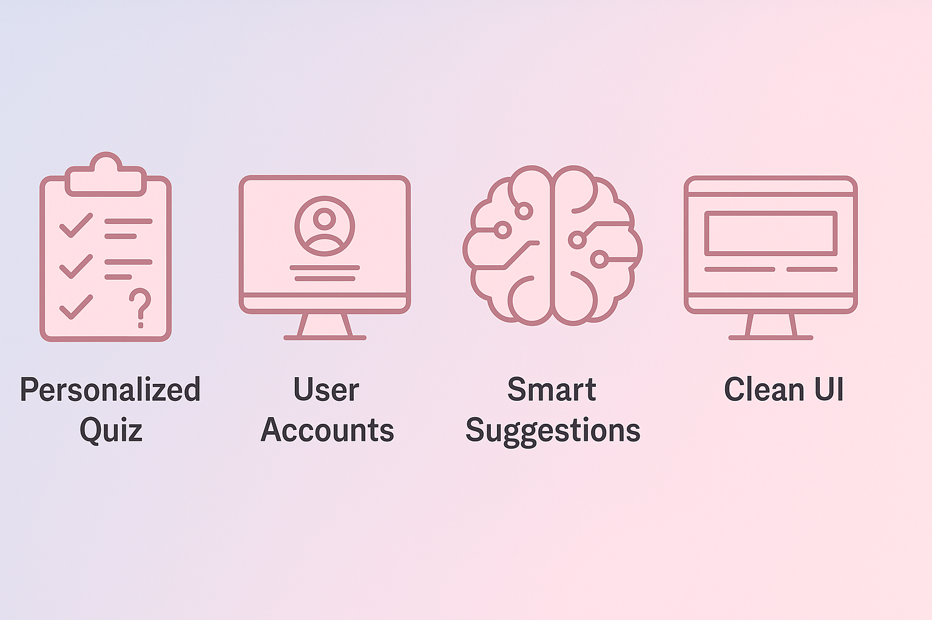




Proposed System
Our proposed system features a personalized interest-based quiz across six categories. It includes a user account system for tracking progress and a smart suggestion engine. A clean, dynamic UI provides seamless interaction and real-time results.
Personalized Quiz
User Accounts
Smart Suggestions
Clean UI
Dynamic results in a user-friendly interface.
Six categories for comprehensive interest assessment.
Enables tracking of career exploration progress.
Database-integrated for intelligent career recommendations.

Slide 10
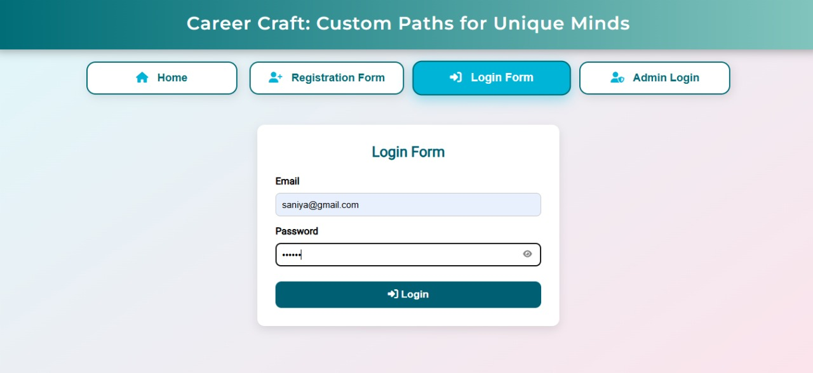
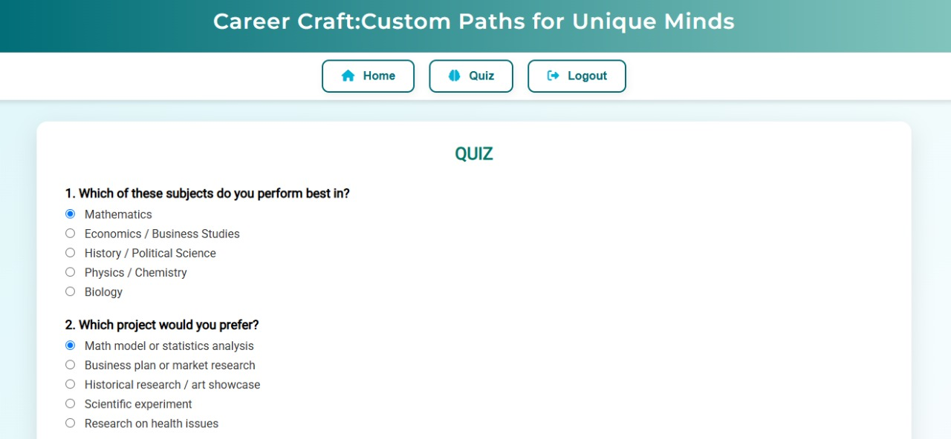
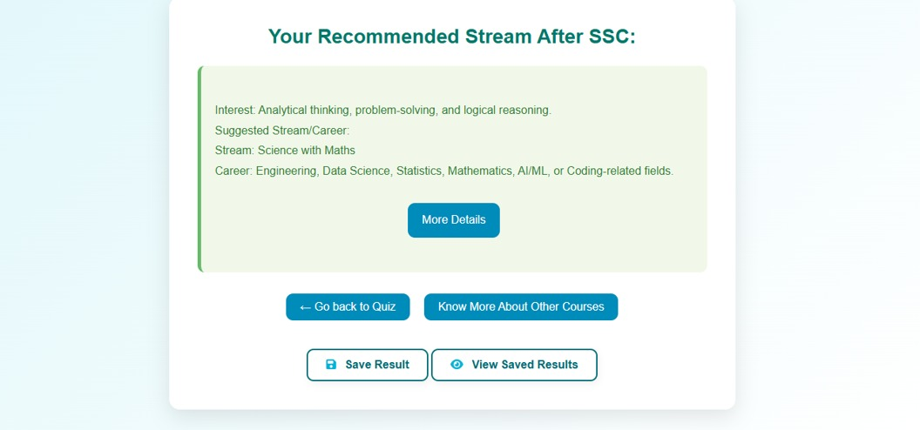




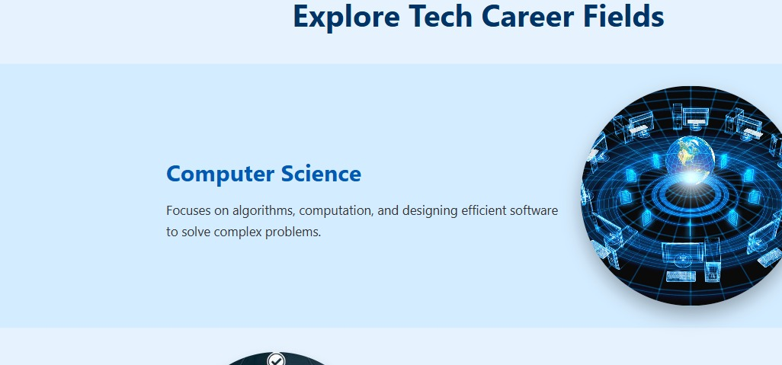
MODULES
User Journey
The user journey is designed to be straightforward . From initial login or registration, users proceed to attempt a personalized quiz. Upon completion, they can view their results instantly and then explore acurated list of career options tailored to their profile.
2. Attempt Quiz
Take the personalized interest-based quiz.
3. View Result
Receive instant, tailored career suggestions.
4. Explore Career Options
1. Login/Register
Browse detailed career paths and resources.
Securely access the platform.
2
3
1
4

Slide 11
SYSTEM REQUIRMENTS
Our platform leverages a robust and widely-used technology stack. The frontend is built with
standard web technologies, ensuring broad compatibility. The backend and database provide
powerful data handling and dynamic content capabilities.
1
frontend
HTML ,J2EE&CSS
2
3
Backend
MySQL
Coding language
Java/J2EE.JSP
4
Operating System
Windows 10/11

Slide 12
HARDWARE REQUIRMENTS
(i3 6th Generation or above)
(8GB)
(160 GB SSD)
PROCESSOR
RAM
HARD DISK

Slide 13
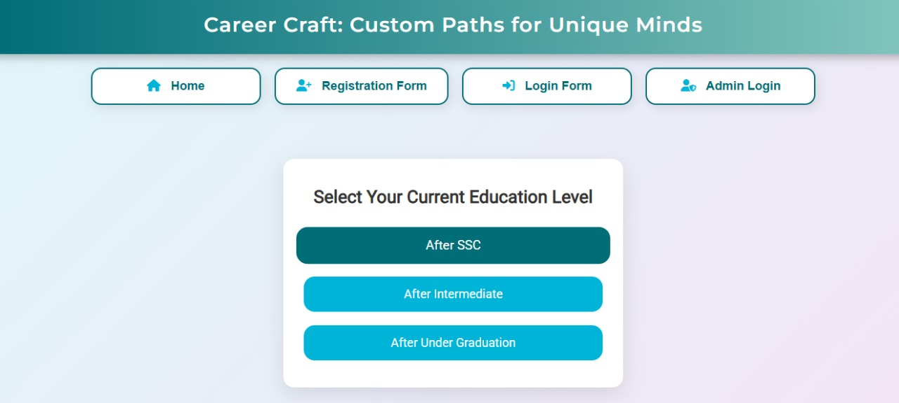
Discover Your Future: An Interest-Based Career Quiz
Unlock your potential with our new interest-based quiz. This presentation outlines the innovative features and benefits of
our career guidance tool. It’s designed to help students find their ideal path.

Slide 14






Quiz Categories: Exploring Your Strengths
Analytical Thinking
Creativity
Problem-solving and critical analysis.
Innovative and imaginative approaches.
Technical Skills
Communication
Proficiency in specific tools.
Effective expression and listening.
Logical Reasoning
Memory Skills
Structured thought processes.
Recall and retention abilities.

Slide 15
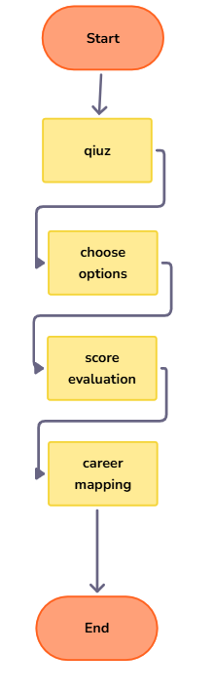




Quiz Logic: A Seamless User Journey
Start Quiz
Begin your personalized assessment.
Choose Options
Select answers based on interests.
Score Evaluation
System processes your responses.
Career Mapping
Receive tailored career suggestions.

Slide 16
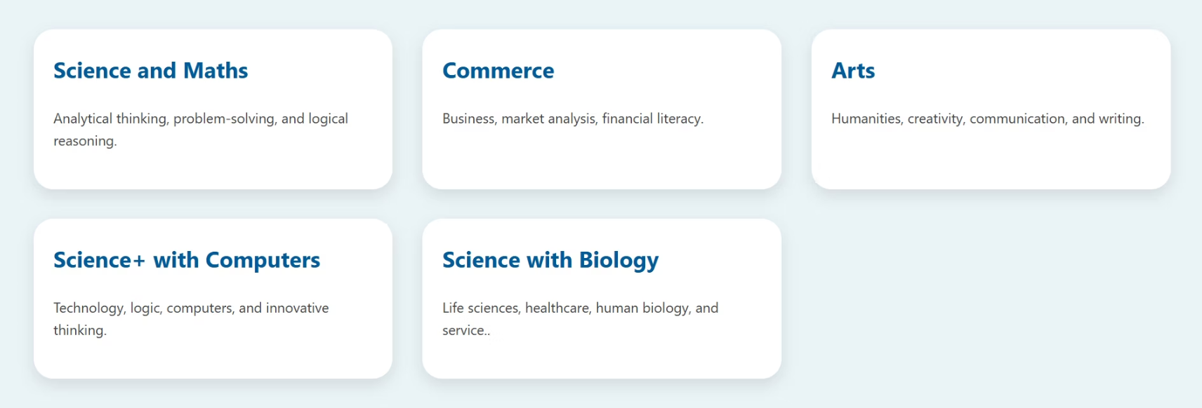
Personalized Career Suggestions

Slide 17
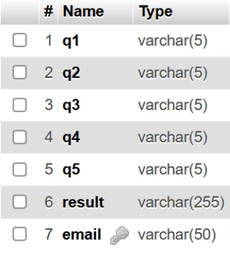
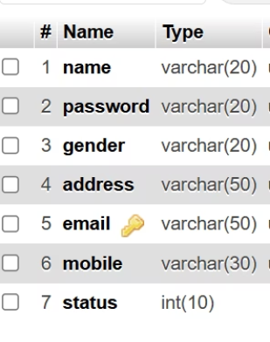
Database Design: Structured Data
User Table
Quiz’s Table
Stores user credentials and profile information.
Records quiz outcomes and career matches.
Name
questions
password
Quiz Score
gender
email(fk)
address
email
mobile

Slide 18



Robust Security Features
User Authentication
Input Validation
Does not allow user to login unless admin approves the entry
\
Maps user email to correct password and checks for validation

Slide 19
APPLICATION
1. 🎓 Student Career Planning
Helps 10th, Inter, and UG students choose suitable career paths based on their interests
and strengths.
2. 🏫 Used in Schools & Colleges
Can be implemented in educational institutions to assist career counselors and guide students effectively.
3. 🌐 Online Career Guidance Platform
Works as a web-based tool for students to access career suggestions anytime, anywhere.
4. 👨‍👩‍👧 Parental Support Tool
Assists parents in understanding their child’s interests to make better academic and career decisions.
5. 📊 Data-Driven Counseling
Generates reports and results from quiz responses for personalized career guidance.

Slide 20

Conclusion
Helped students discover suitable career paths
1
Simple, interactive quiz-driven solution
2
Real-time career suggestions based on interests
3
Scalable for larger student audiences
4

Slide 21

THANK YOU

